Slide 1


The Machine Learning Process

Slide 2




The Machine Learning Process
Data Pre-Processing
Import the data
Clean the data
Split into training & test sets
Feature Scaling
Modelling
Build the model
Train the model
Make predictions
Evaluation
Calculate performance metrics
Make a verdict

Slide 3


Training Set & Test Set

Slide 4
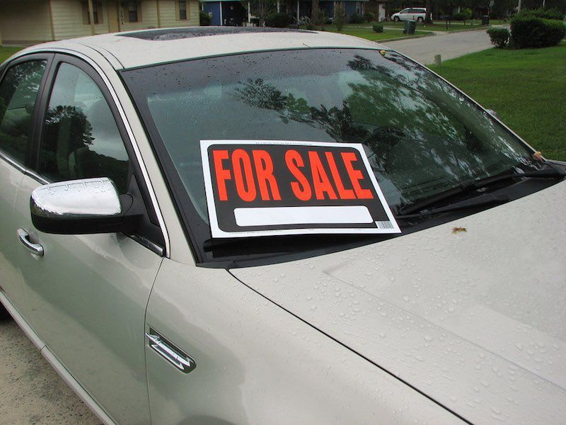








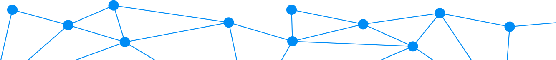
Training Set & Test Set
Training Set and Test set
~
Train 80%
𝑦 ‘= 𝑏₀ + 𝑏₁𝑋₁ + 𝑏₂𝑋₂
Test 20%
V.S.
Predicted values 𝑦i
Actual values 𝑦

Slide 5
Feature Scaling

Slide 6
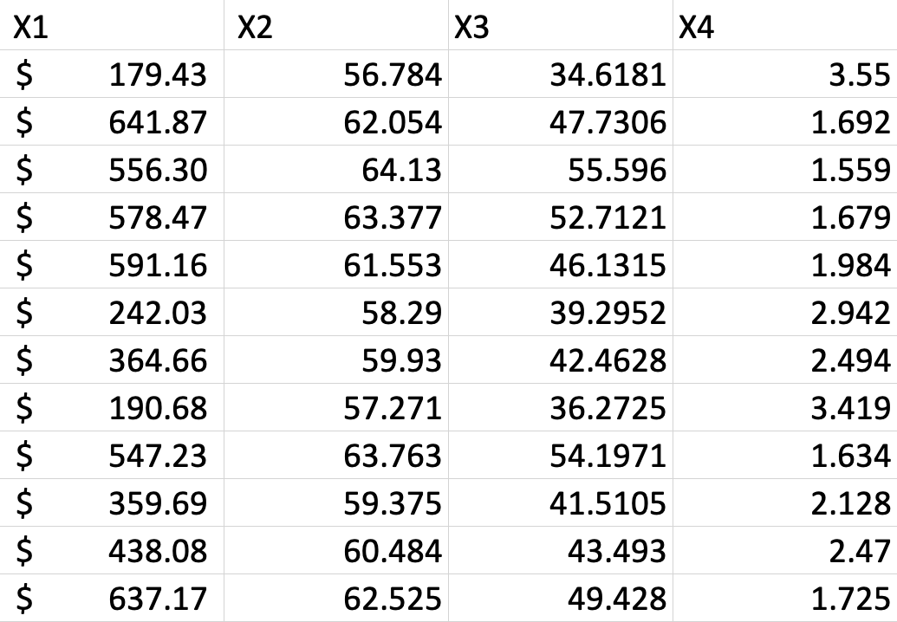
Feature Scaling
Feature Scaling

Slide 7
Feature Scaling
Normalization
Standardization
Normalization
Standardization
𝑋 − 𝑋_{min}
_{𝑋' =} 𝑋 − 𝜇
𝜎
[-3 ; +3]
𝑋' =
^{𝑋max} ^{− 𝑋min}
[0 ; 1]

Slide 8




Feature Scaling
Feature Scaling
70,000 $
10,000
60,000 $
8,000
52,000 $
45 yrs
1
44 yrs
4
40 yrs

Slide 9
Feature Scaling
Feature Scaling
Normalization
Normalization
𝑋 − 𝑋_{min}
𝑋' =
^{𝑋max} ^{− 𝑋min}
[0 ; 1]

Slide 10
Feature Scaling
Feature Scaling
70,000 $ | 45 yrs
60,000 $ | 44 yrs
52,000 $ | 40 yrs

Slide 11
Feature Scaling
Feature Scaling
1
0.444
0
45 yrs
44 yrs
40 yrs

Slide 12
Feature Scaling
Feature Scaling
1 | 1
0.444 | 0.75
0 | 0

Slide 13


Regression

Slide 14
Simple Linear Regression

Slide 15
SiSimple Linear Regressionmple Linear Regression
𝑦 ' = 𝑏₀+ 𝑏₁𝑋₁
Dependent variable
Independent variable
y-intercept (constant)
Slope coefficient

Slide 16
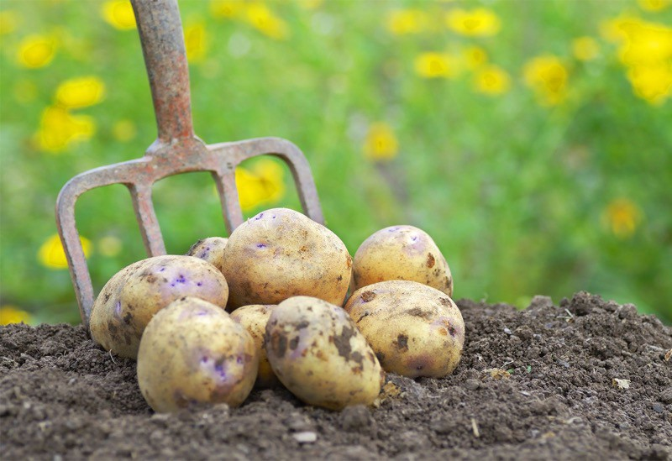


Simple Linear Regression
SiSimple Linear Regressionmple Linear Regression
Each point represents a separate harvest
𝑦 [tonnes] (Potato yield)
~
𝑦 ‘ = 𝑏₀ + 𝑏₁𝑋₁
𝑃𝑜𝑡𝑎𝑡𝑜𝑒𝑠 [𝑡] = 𝑏₀ + 𝑏₁×𝐹𝑒𝑟𝑡𝑖𝑙𝑖𝑧𝑒𝑟 [𝑘𝑔]
+3𝑡
8𝑡
𝑏_{i} = 8[𝑡]
𝑡
𝑏1 = 3[ ]
+1𝑘𝑔
𝑋_{i} [kg] (Nitrogen Fertilizer)
"
𝑘𝑔

Slide 17
Ordinary Least Squares

Slide 18
Simple Linear Regression
SiSimple Linear Regressionmple Linear Regression
𝑦 [tonnes] (Potato yield)
Ordinary Least Squares:
𝑦_{i}
𝑟𝑒𝑠𝑖𝑑𝑢𝑎𝑙: 𝜀i = 𝑦i – yi’
yi’
𝑦_{I}
_{Yi’}
𝑦 '= 𝑏₀ + 𝑏₁𝑋₁
𝑏₀, 𝑏₁ such that:
𝑆𝑈𝑀(𝑦_{i} − 𝑦_{ii’})² is minimized
𝑋_{i} [kg] (Nitrogen Fertilizer)

Slide 19
Multiple Linear Regression

Slide 20
MMultiple Linear Regressionultiple Linear Regression
𝑦 '= 𝑏₀ + 𝑏₁𝑋₁ + 𝑏₂𝑋₂ + ⋯ + 𝑏_{n}𝑋_{n}
Dependent variable
Independent variable 1
Independent variable 2
Independent variable n
y-intercept (constant)
Slope coefficient 1
Slope coefficient 2
Slope coefficient n

Slide 21


Multiple Linear Regression
MMultiple Linear Regressionultiple Linear Regression
~
𝑃𝑜𝑡𝑎𝑡𝑜𝑒𝑠[𝑡] = 8𝑡 + 3 t ×𝐹𝑒𝑟𝑡𝑖𝑙𝑖𝑧𝑒𝑟[𝑘𝑔]− 0.54 ^{t} ×𝐴𝑣𝑔𝑇𝑒𝑚𝑝 °𝐶 + 0.04
kg °c
t
×𝑅𝑎𝑖𝑛[𝑚𝑚]
mm

Slide 22
Assumptions Of Linear Regression

Slide 23
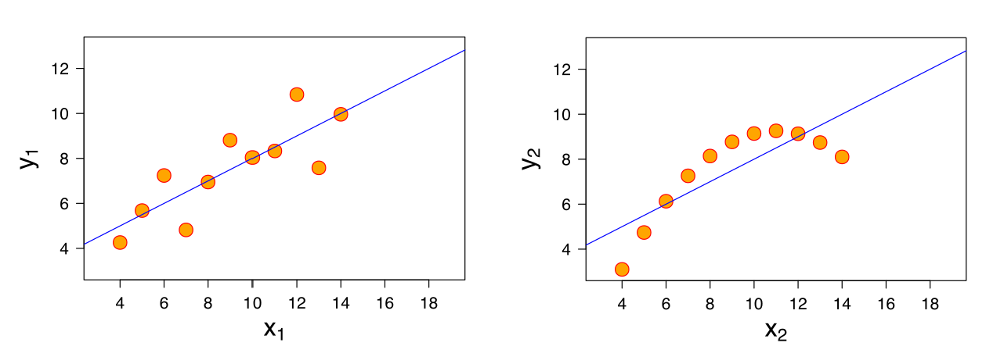


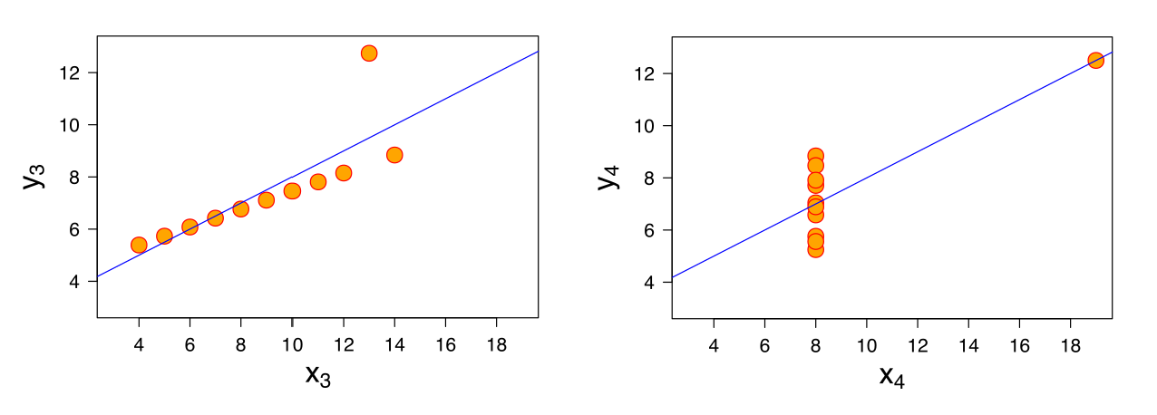
AAssumptions Of Linear Regressionssumptions of Linear Regression
Anscombe's quartet (1973):

Slide 24




Assumptions of Linear Regression
AAssumptions Of Linear Regressionssumptions of Linear Regression
1. Linearity
(Linear relationship between Y and each X)
2. Homoscedasticity
(Equal variance)
3. Multivariate Normality
(Normality of error distribution)
4. Independence
(of observations. Includes “no autocorrelation”)
5. Lack of Multicollinearity
(Predictors are not correlated with each other)
𝑋"~ 𝑋# 𝑋"~ 𝑋#
6. The Outlier Check
(This is not an assumption, but an “extra”)

Slide 25








Slide 26











X₃
X₄
X₅
X₂
X₆
X₁
y
X₇
Why?

Slide 27
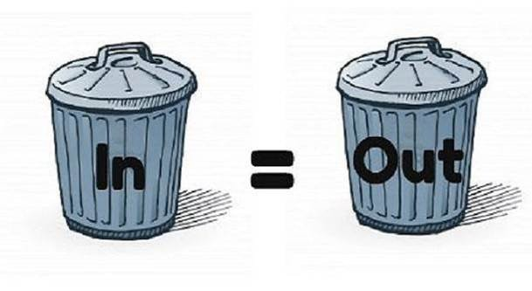
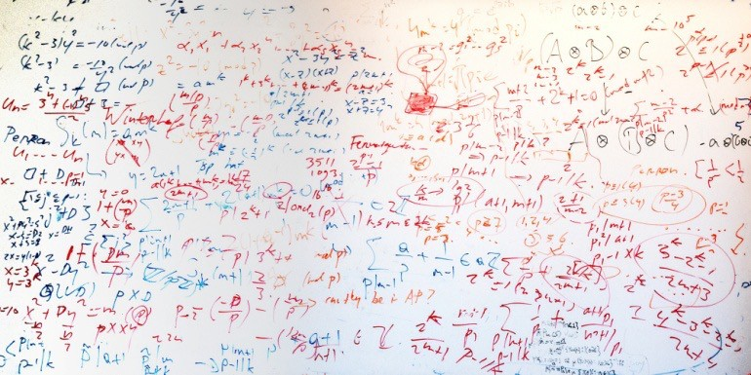
1)
2)

Slide 29


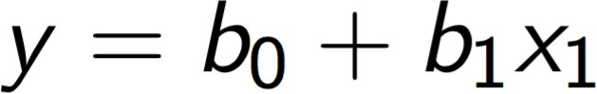
Simple Linear
Regression
Multiple Linear
Regression
Polynomial Linear
Regression

Slide 30




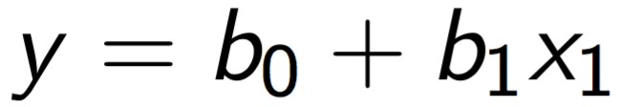


y
x1

Slide 31






y
x1

Slide 32





y
x1

Slide 33





Slide 34




Polynomial Linear
Regression

Slide 35



Slide 36





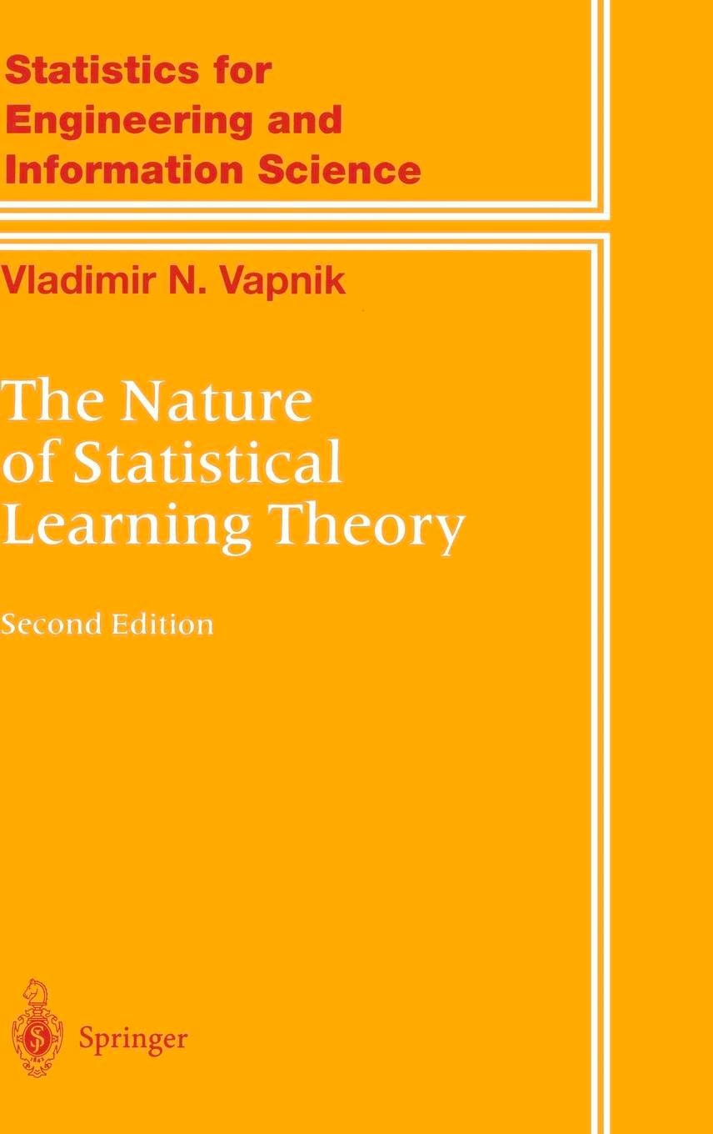
1992
Vladimir Vapnik

Slide 37
ε-Insensitive Tube
Ordinary Least Squares SUM (y – ŷ)² -> min
x2
x2
ε ε
x1
x1

Slide 38
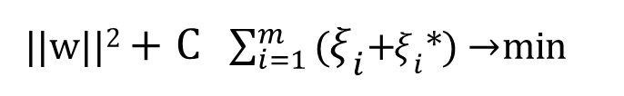
1
2
||w||²+C $\sum_{i=1}^{m}{\text{(}{\text{ξ}}_{i}\text{+}{\text{ξ}}_{i}\text{∗}\text{)}}$→ min
Ordinary Least Squares SUM (y – ŷ)² -> min
ε-Insensitive Tube Slack Variables ξi and ξi*
x2
x2
ε ε
ξ₅
ξ₃
ξ₂
*
ξ₄
ξ₁
*
x1
x1

Slide 39







Slide 40



x2
ε
ε
x1

Slide 42








Slide 43
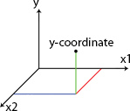








































Y
X2
Split 1
Split 3
200
Split 2
170
Split 4
20
40
X1

Slide 44


Slide 45


X2
Split 1
20
X1

Slide 46
X1 < 20
Yes
No

Slide 47
X2
Split 1
Split 2
170
20
X1

Slide 48
X1 < 20
Yes
No

Slide 49
X1 < 20
Yes
No
X2 < 170
Yes
No

Slide 50
X2
Split 1
Split 3
200
Split 2
170
20
X1

Slide 51
X1 < 20
Yes
No
X2 < 170
Yes
No

Slide 52
X1 < 20
Yes
No
X2 < 200
X2 < 170
Yes
No
Yes
No

Slide 53
X2
Split 1
Split 3
200
Split 2
170
Split 4
20
40
X1

Slide 54
X1 < 20
Yes
No
X2 < 200
X2 < 170
Yes
No
Yes
No

Slide 55
X1 < 20
Yes
No
X2 < 200
X2 < 170
Yes
No
Yes
No
X1 < 40
Yes
No

Slide 56


Y
X2
Split 1
65.7
Split 3
1023
200
Split 2
170
300.5
-64.1
0.7
Split 4
20
40
X1

Slide 57
X1 < 20
Yes
No
X2 < 200
X2 < 170
Yes
No
Yes
No
X1 < 40
Yes
No

Slide 58
X1 < 20
Yes
No
X2 < 200
X2 < 170
Yes
No
Yes
No
300.5
65.7
X1 < 40
1023
Yes
No
-64.1
0.7

Slide 60



Slide 61
STEP 1: Pick at random K data points from the Training set.
STEP 2: Build the Decision Tree associated to these K data points.
STEP 3: Choose the number Ntree of trees you want to build and repeat STEPS 1 & 2
STEP 4: For a new data point, make each one of your Ntree trees predict the value of Y to for the data point in question, and assign the new data point the average across all of the predicted Y values.

Slide 62


Classification

Slide 63

















Classification?
Classification: a Machine Learning technique to identify the category of new observations based on training data.
Likely to stay
Likely to leave
Dogs
Cats

Slide 64
Logistic Regression

Slide 65





Logistic Regression
Logistic regression: predict a categorical dependent variable from a number of independent variables.
𝑦 [yes/no]
(Took up offer?)
~
YES
YES
81%
Will purchase health insurance: Yes / No
Age
≥ 50%
< 50%
42%
𝑝
ln
= 𝑏₀ + 𝑏₁𝑋₁
NO
1 − 𝑝
NO
18
35 45
60
𝑋_{i} [yrs] (Age)

Slide 66


Logistic Regression
Logistic Regression
~
Will purchase health insurance: Yes / No
Age
Income
Level of Education
Family or Single
𝑝
ln
= 𝑏₀ + 𝑏₁𝑋₁ +𝑏₂𝑋₂ + 𝑏₃𝑋₃ + 𝑏₄𝑋₄
1 − 𝑝

Slide 67
Maximum Likelihood

Slide 68


Maximum Likelihood
𝑦 [yes/no]
(Took up offer?)
𝑦 [yes/no]
(Took up offer?)
YES
YES
_{0.920.95} 0.98
1- 0.96
1-0.58
0.54
1- 0.10
1- 0.04
0.03
1- 0.01
NO
NO
18
60
𝑋_{i} [yrs] (Age)
18
60
𝑋_{i} [yrs] (Age)
Likelihood = 0.03 x 0.54 x 0.92 x 0.95 x 0.98 x (1 – 0.01) x (1 – 0.04) x (1 – 0.10) x (1 – 0.58) x (1 – 0.96)
Likelihood = 0.00019939

Slide 69
Maximum Likelihood
𝑦 [yes/no]
(Took up offer?)
Likelihood = 0.00007418
Likelihood = 0.00012845
YES
Likelihood = 0.00016553
Likelihood = 0.00019939
Best Curve <= Maximum Likelihood
NO
18
60
𝑋_{i} [yrs] (Age)

Slide 70




Slide 71























Before K-NN
After K-NN
X2
x2
Category 2
Category 2
New data point
K-NN
New data point assigned to Category 1
Category 1
Category 1
x1
x1

Slide 72
STEP 1: Choose the number K of neighbors
STEP 2: Take the K nearest neighbors of the new data point, according to the Euclidean distance
STEP 3: Among these K neighbors, count the number of data points in each category
STEP 4: Assign the new data point to the category where you counted the most neighbors
Your Model is Ready

Slide 73















STEP 1: Choose the number K of neighbors: K = 5
x2
Category 2
New data point
Category 1
x1

Slide 74
P2(x2,y2)
y
y2
y1
P1(x1,y1)
x1
x2
x

Slide 75






x2
Category 2
Category 1: 3 neighbors
Category 2: 2 neighbors
New data point
Category 1
x1

Slide 76


Slide 77
x2
x1

Slide 78


Maximum Margin
x2
Support Vectors
x1

Slide 79


Maximum Margin
x2
Positive Hyperplane
Maximum Margin Hyperplane
(Maximum Margin Classifier)
Support Vectors
Negative Hyperplane
x1

Slide 81


Slide 82

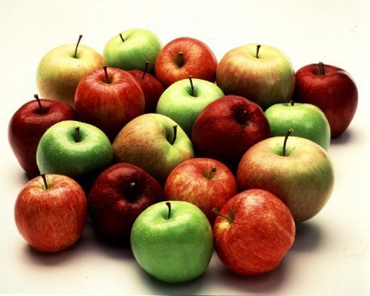
x2
x1

Slide 83

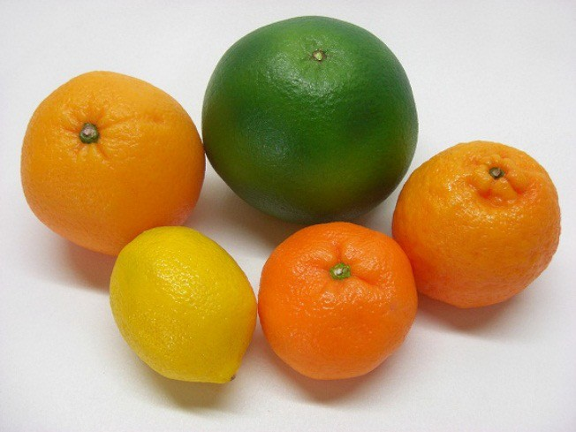
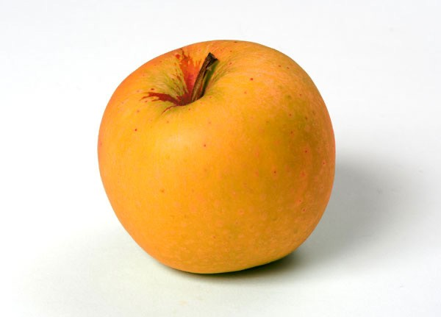
x2
Support Vectors
x1

Slide 85




































Linearly Separable
Not Linearly Separable
x2
x2
x1
x1

Slide 86



Slide 87


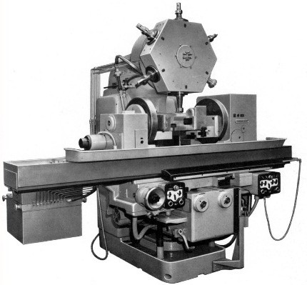

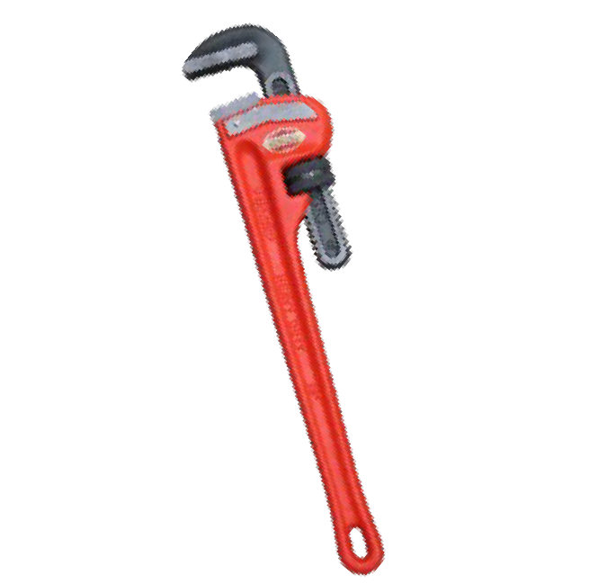



m1 m1 m1 m1 m1 m1 m1 m1 m1 m1
m1 m1 m1
m2 m2 m2 m2 m2 m2 m2 m2 m2 m2

Slide 88




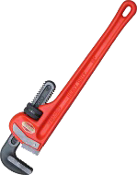

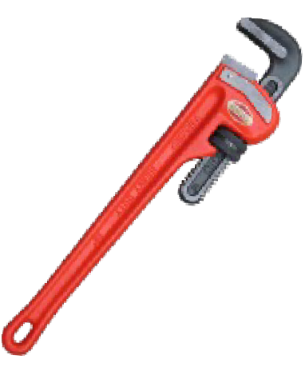

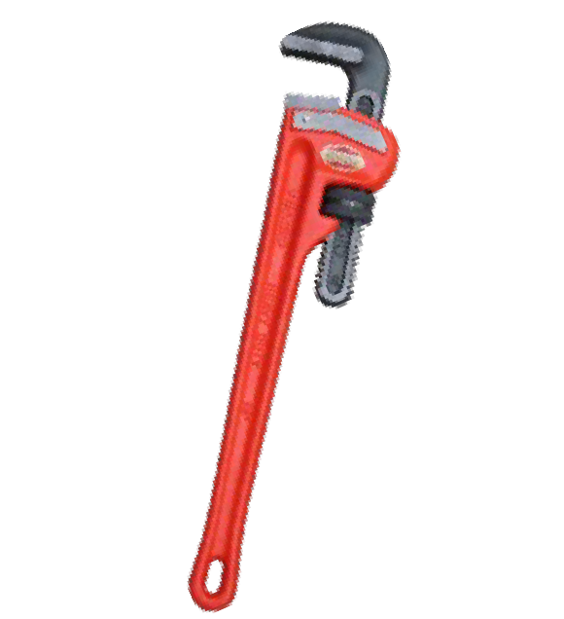

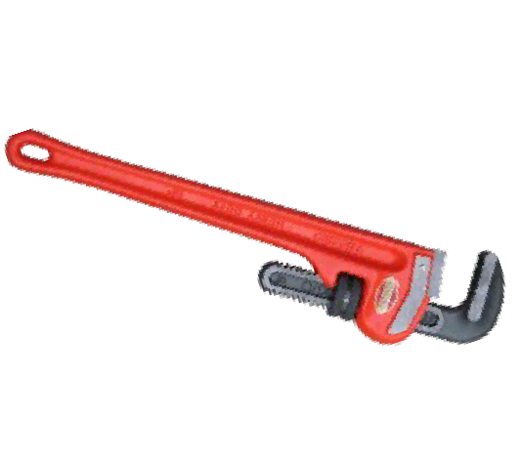









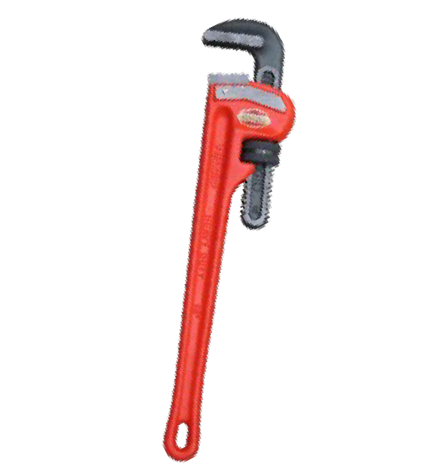









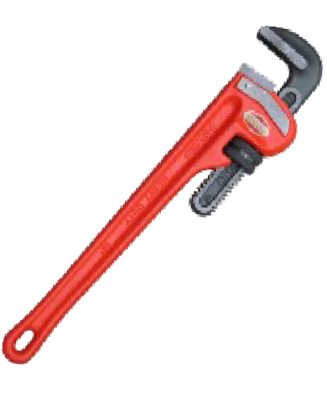









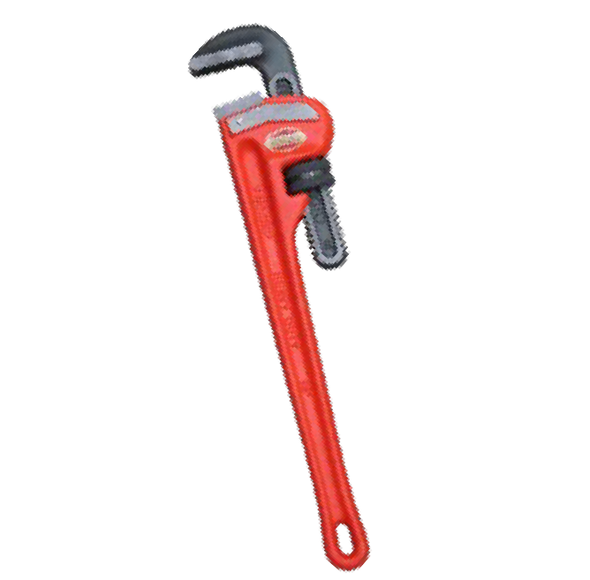




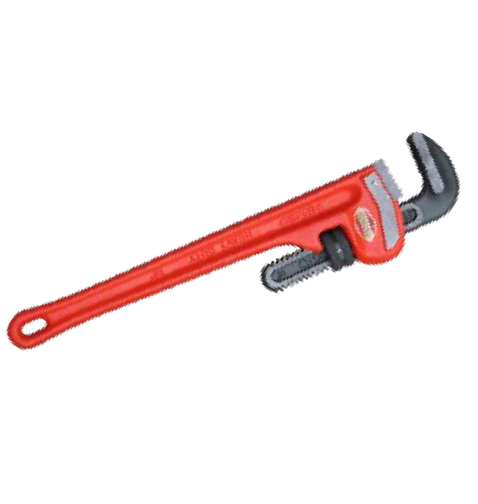







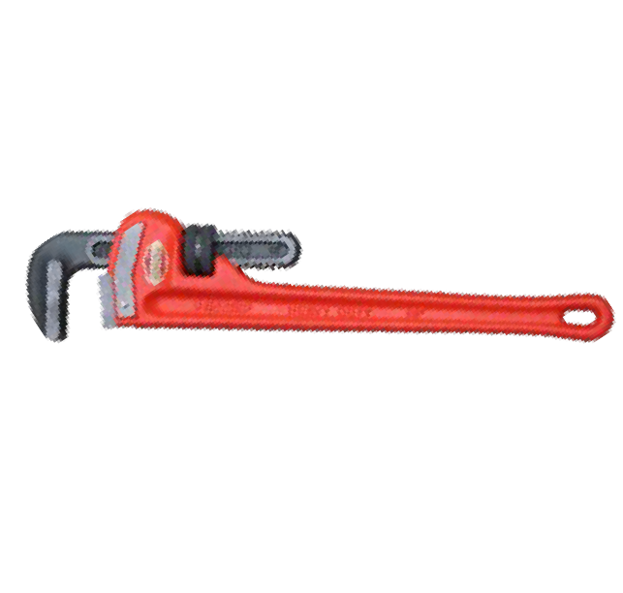






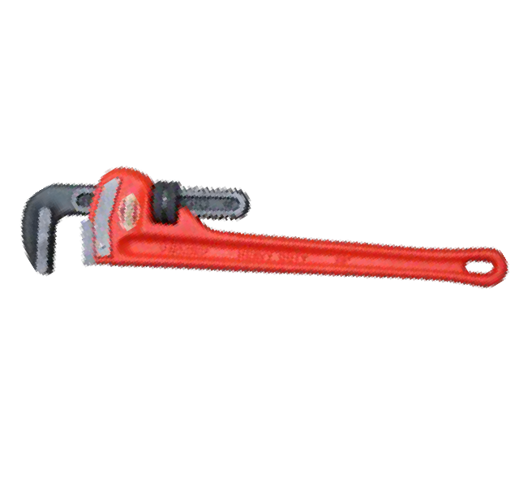


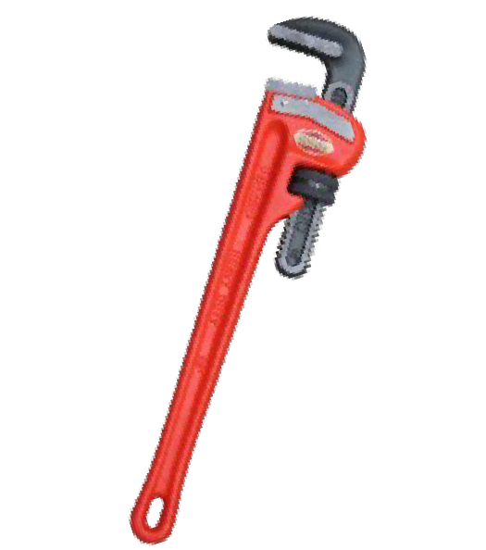
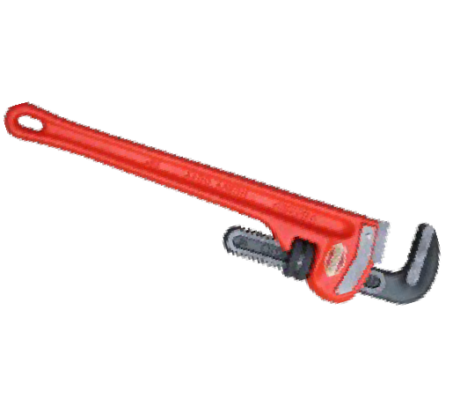




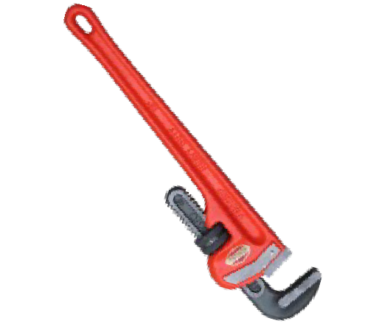



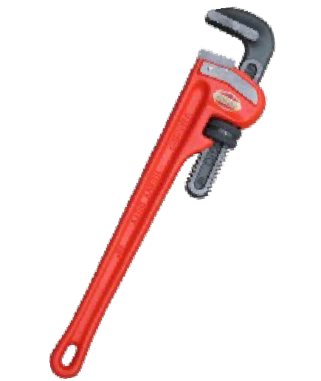














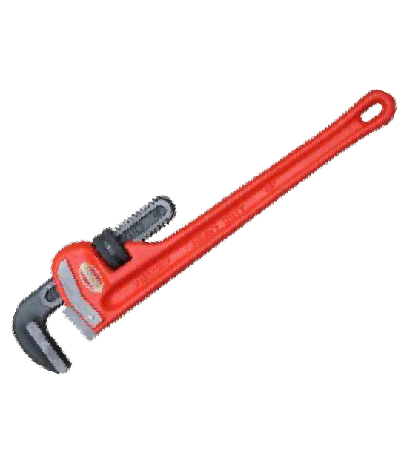
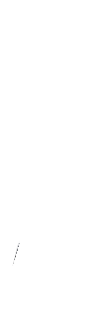








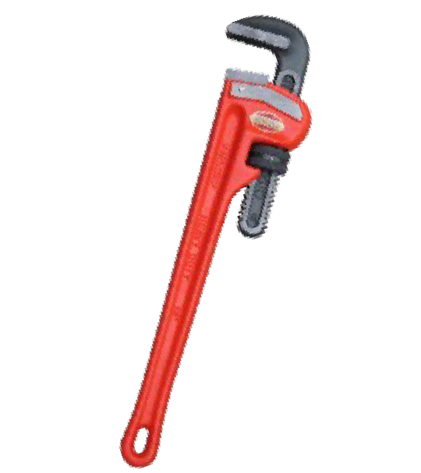








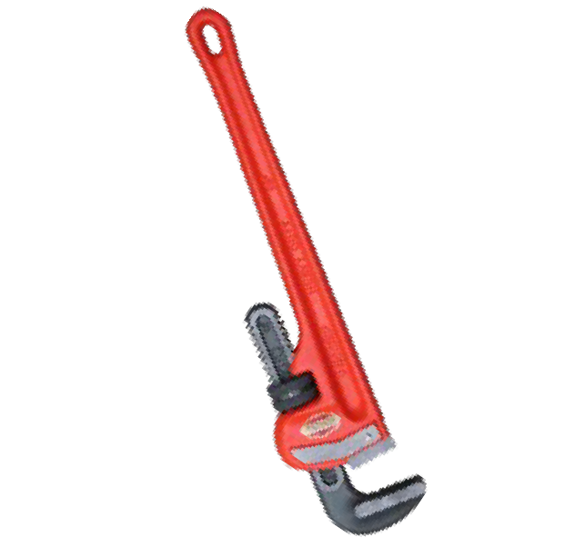





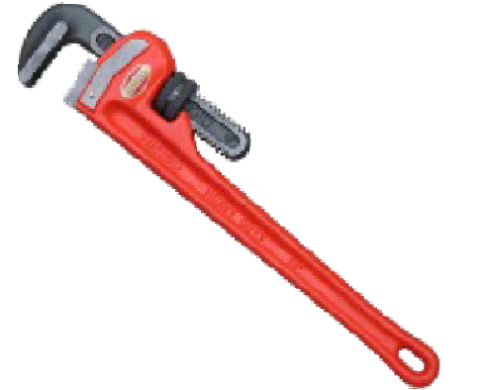


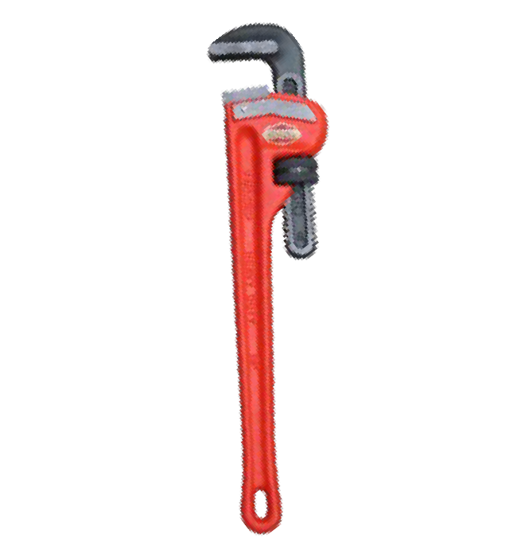









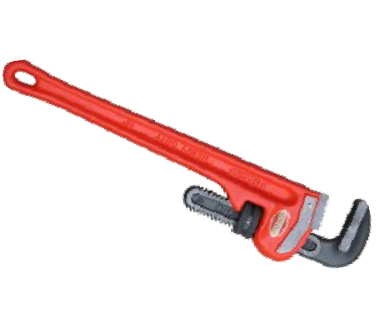











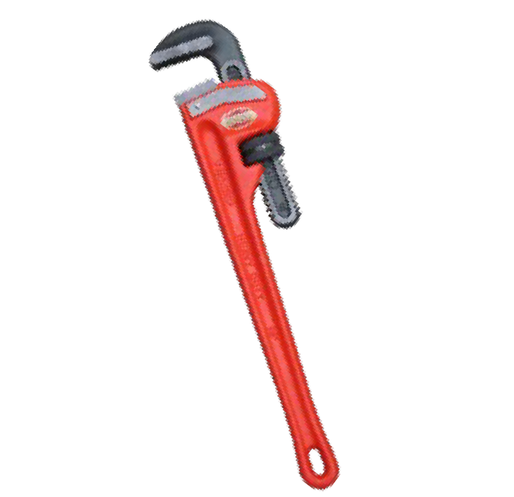








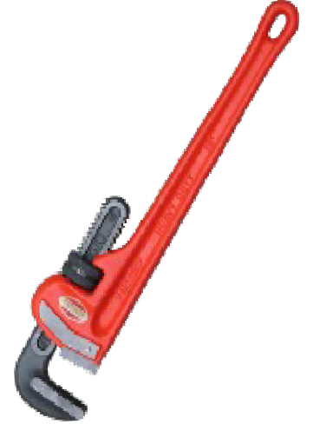
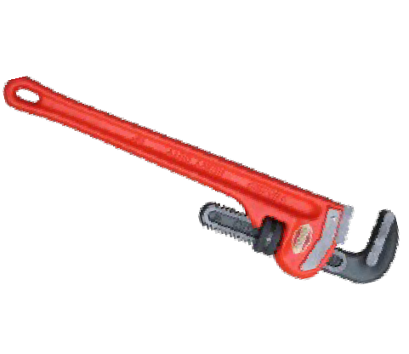













Slide 89







Slide 90
m2

Slide 91

m2

Slide 92
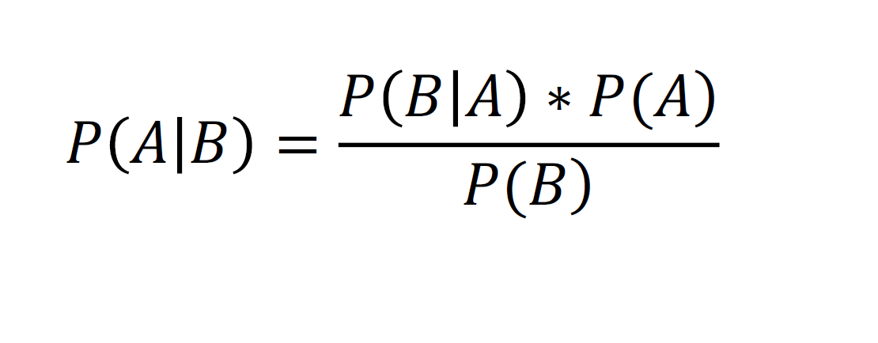
_{𝑃 𝐴 𝐵 =} 𝑃 𝐵 𝐴 ∗ 𝑃(𝐴)
𝑃(𝐵)

Slide 93







Slide 94



Slide 96




Slide 97











Slide 98

















Slide 99



Slide 100



















Slide 101






Slide 102




Slide 104


Slide 105



_{𝑃 𝐴 𝐵 =} 𝑃 𝐵 𝐴 ∗ 𝑃(𝐴)
𝑃(𝐵)

Slide 106

















Salary
X2
CaDtreivgeosry 2
CWataelgkosry 1
Age
X1

Slide 107

Salary
Drives
Walks
New data point
Age

Slide 108



Slide 109
_{𝑃 𝐴 𝐵 =} 𝑃 𝐵 𝐴 ∗ 𝑃(𝐴)
𝑃(𝐵)

Slide 110


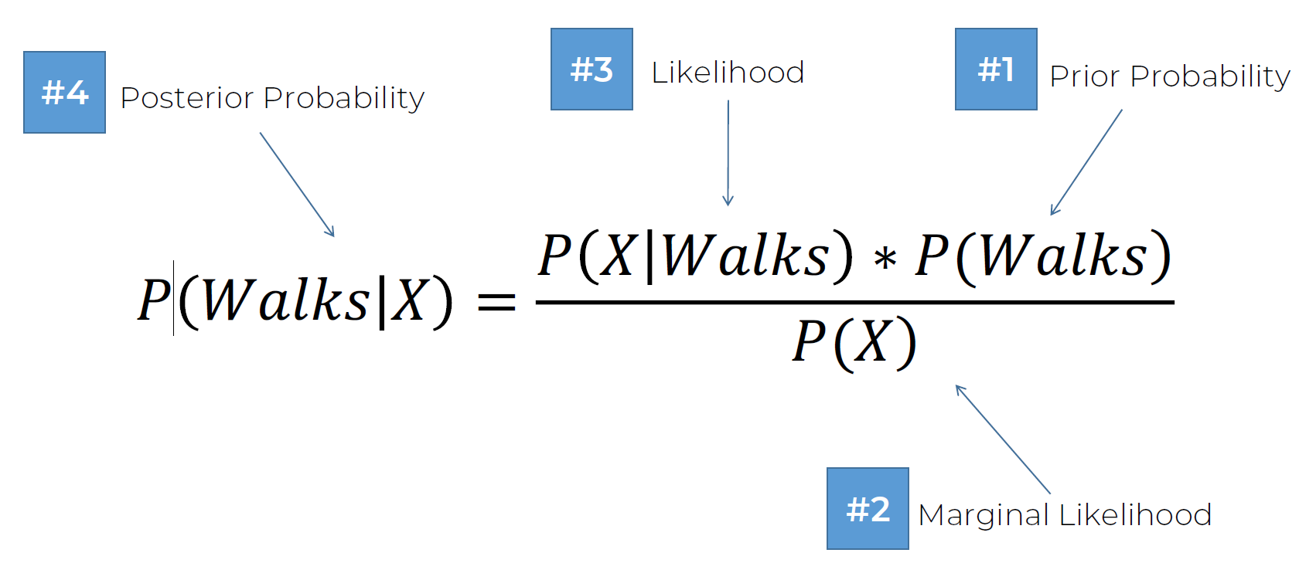
#3
#1
#4
Likelihood
Prior Probability
Posterior Probability
_{𝑃 𝑊𝑎𝑙𝑘𝑠 𝑋 =} 𝑃 𝑋 𝑊𝑎𝑙𝑘𝑠 ∗ 𝑃(𝑊𝑎𝑙𝑘𝑠)
𝑃(𝑋)
#2
Marginal Likelihood

Slide 111

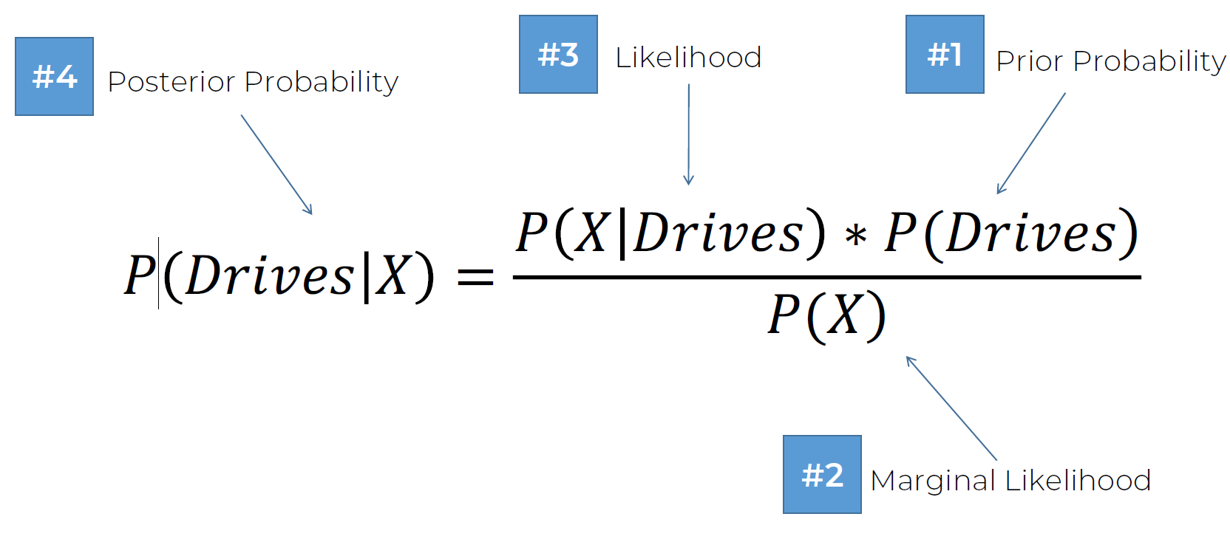
#3
#1
#4
Likelihood
Prior Probability
Posterior Probability
_{𝑃 𝐷𝑟𝑖𝑣𝑒𝑠 𝑋 =} 𝑃 𝑋 𝐷𝑟𝑖𝑣𝑒𝑠 ∗ 𝑃(𝐷𝑟𝑖𝑣𝑒𝑠)
𝑃(𝑋)
#2
Marginal Likelihood

Slide 112

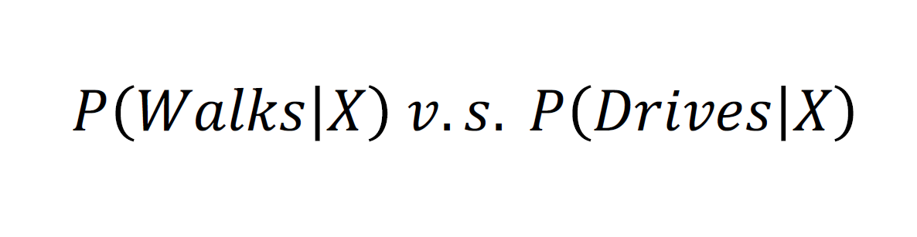
𝑃 𝑊𝑎𝑙𝑘𝑠 𝑋 𝑣. 𝑠. 𝑃 𝐷𝑟𝑖𝑣𝑒𝑠 𝑋

Slide 113



Slide 114


Salary
Drives
Walks
Age

Slide 115




_{𝑃(𝑊𝑎𝑙𝑘𝑠) =} 𝑁𝑢𝑚𝑏𝑒𝑟 𝑜𝑓 𝑊𝑎𝑙𝑘𝑒𝑟𝑠
Salary
Drives
𝑇𝑜𝑡𝑎𝑙 𝑂𝑏𝑠𝑒𝑟𝑣𝑎𝑡𝑖𝑜𝑛𝑠
₌ 10
Walks
𝑃 𝑊𝑎𝑙𝑘𝑠
30
Age

Slide 116
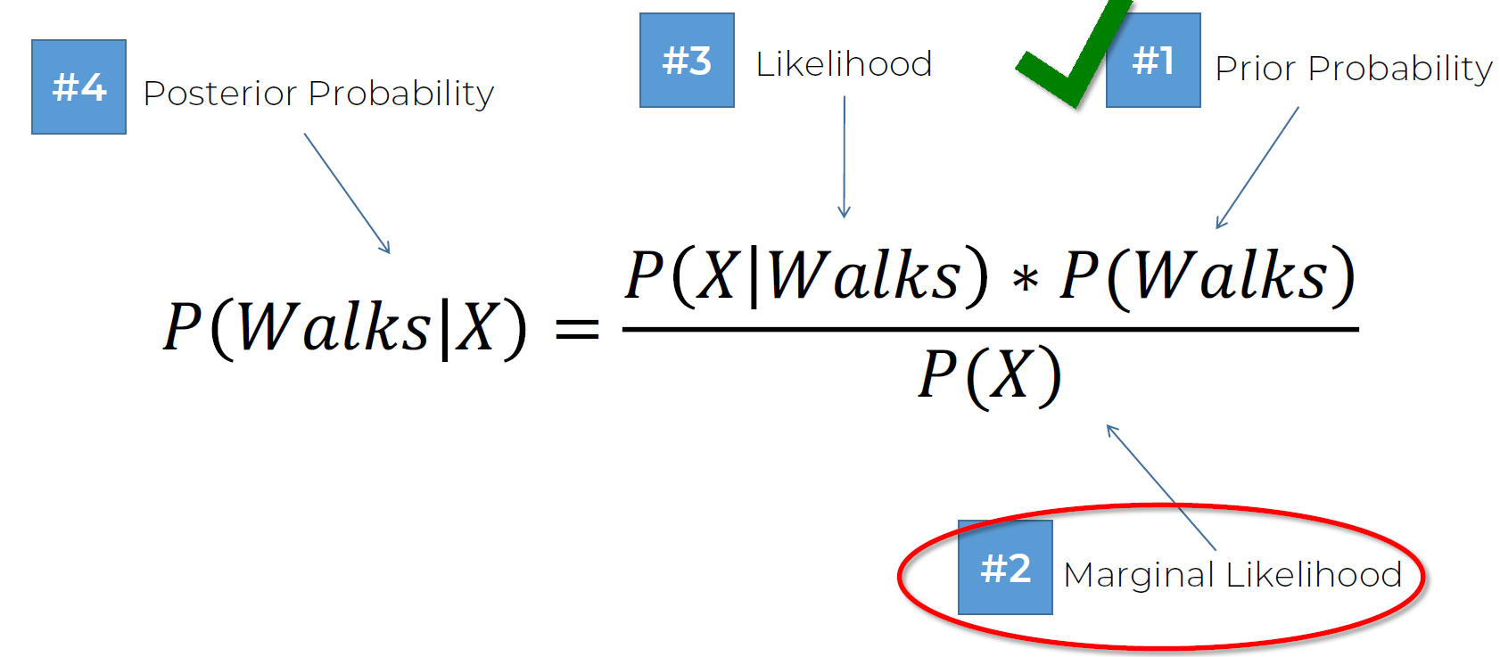



#3
#4
Likelihood
#1
Prior Probability
Posterior Probability
_{𝑃 𝑊𝑎𝑙𝑘𝑠 𝑋 =} 𝑃 𝑋 𝑊𝑎𝑙𝑘𝑠 ∗ 𝑃(𝑊𝑎𝑙𝑘𝑠)
𝑃(𝑋)
#2
Marginal Likelihood

Slide 117


_{𝑃(𝑋) =} 𝑁𝑢𝑚𝑏𝑒𝑟 𝑜𝑓 𝑆𝑖𝑚𝑖𝑙𝑎𝑟 𝑂𝑏𝑠𝑒𝑟𝑣𝑎𝑡𝑖𝑜𝑛𝑠
Salary
Drives
𝑇𝑜𝑡𝑎𝑙 𝑂𝑏𝑠𝑒𝑟𝑣𝑎𝑡𝑖𝑜𝑛𝑠
₌ 4
Walks
𝑃 𝑋
30
Age

Slide 118
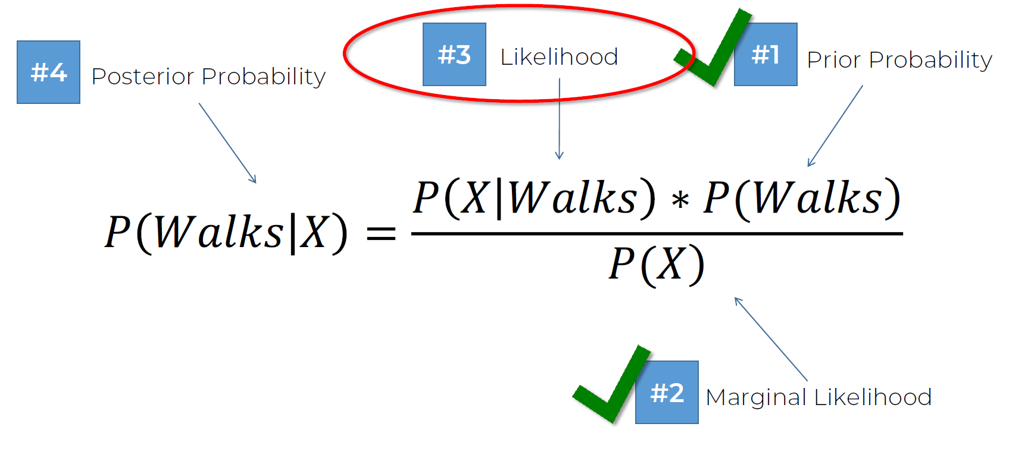


#3
#4
Likelihood
#1
Prior Probability
Posterior Probability
_{𝑃 𝑊𝑎𝑙𝑘𝑠 𝑋 =} 𝑃 𝑋 𝑊𝑎𝑙𝑘𝑠 ∗ 𝑃(𝑊𝑎𝑙𝑘𝑠)
𝑃(𝑋)
#2
Marginal Likelihood

Slide 119







𝑁𝑢𝑚𝑏𝑒𝑟 𝑜𝑓 𝑆𝑖𝑚𝑖𝑙𝑎𝑟
𝑂𝑏𝑠𝑒𝑟𝑣𝑎𝑡𝑖𝑜𝑛𝑠
Salary
Drives
𝐴𝑚𝑜𝑛𝑔 𝑡ℎ𝑜𝑠𝑒 𝑤ℎ𝑜 𝑊𝑎𝑙𝑘
𝑃(𝑋|𝑊𝑎𝑙𝑘𝑠) =
𝑇𝑜𝑡𝑎𝑙 𝑛𝑢𝑚𝑏𝑒𝑟 𝑜𝑓 𝑊𝑎𝑙𝑘𝑒𝑟𝑠
Walks
₌ 3
𝑃 𝑋|𝑊𝑎𝑙𝑘𝑠
10
Age

Slide 120


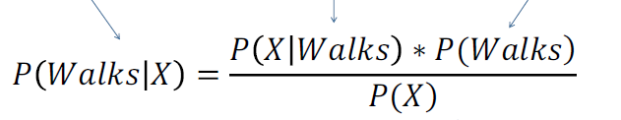
#3 Likelihood
#4
#1
Prior Probability
Posterior Probability
_{𝑃 𝑊𝑎𝑙𝑘𝑠 𝑋 =} 𝑃 𝑋 𝑊𝑎𝑙𝑘𝑠 ∗ 𝑃(𝑊𝑎𝑙𝑘𝑠)
𝑃(𝑋)
#2
Marginal Likelihood

Slide 121
#3 Likelihood
#4
#1
Prior Probability
Posterior Probability
3 ∗ 10
𝑃 𝑊𝑎𝑙𝑘𝑠 𝑋 = ¹⁰ ₄ ³⁰ = 0.75
30
#2
Marginal Likelihood

Slide 122






Slide 123
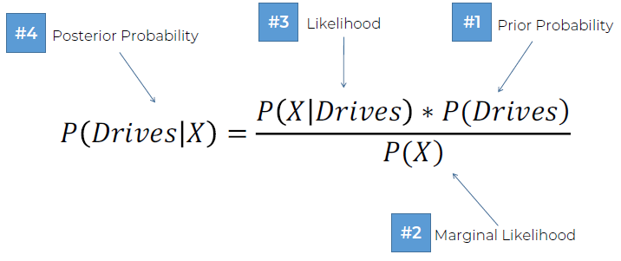
#3
#1
#4
Likelihood
Prior Probability
Posterior Probability
_{𝑃 𝐷𝑟𝑖𝑣𝑒𝑠 𝑋 =} 𝑃 𝑋 𝐷𝑟𝑖𝑣𝑒𝑠 ∗ 𝑃(𝐷𝑟𝑖𝑣𝑒𝑠)
𝑃(𝑋)
#2
Marginal Likelihood

Slide 124


#3 Likelihood
#4
#1
Prior Probability
Posterior Probability
1 ∗ 20
𝑃 𝐷𝑟𝑖𝑣𝑒𝑠 𝑋 = ²⁰ ₄ ³⁰ = 0.25
30
#2
Marginal Likelihood

Slide 125





Slide 126
𝑃 𝑊𝑎𝑙𝑘𝑠 𝑋 𝑣. 𝑠. 𝑃 𝐷𝑟𝑖𝑣𝑒𝑠 𝑋

Slide 127
0.75 𝑣. 𝑠. 0.25

Slide 128
0.75 > 0.25

Slide 129

𝑃 𝑊𝑎𝑙𝑘𝑠 𝑋
> 𝑃 𝐷𝑟𝑖𝑣𝑒𝑠 𝑋

Slide 130
Salary
Drives
Walks
New data point
Age

Slide 131

Salary
Drives
Walks
New data point
Age

Slide 132




Slide 133

#3
#1
#4
Likelihood
Prior Probability
Posterior Probability
_{𝑃 𝐷𝑟𝑖𝑣𝑒𝑠 𝑋 =} 𝑃 𝑋 𝐷𝑟𝑖𝑣𝑒𝑠 ∗ 𝑃(𝐷𝑟𝑖𝑣𝑒𝑠)
𝑃(𝑋)
#2
Marginal Likelihood

Slide 134
Salary
Drives
Walks
Age

Slide 135

_{𝑃(𝐷𝑟𝑖𝑣𝑒𝑠) =} 𝑁𝑢𝑚𝑏𝑒𝑟 𝑜𝑓 𝐷𝑟𝑖𝑣𝑒𝑟𝑠
Salary
Drives
𝑇𝑜𝑡𝑎𝑙 𝑂𝑏𝑠𝑒𝑟𝑣𝑎𝑡𝑖𝑜𝑛𝑠
₌ 20
Walks
𝑃 𝐷𝑟𝑖𝑣𝑒𝑠
30
Age

Slide 136

#3
#4
Likelihood
#1
Prior Probability
Posterior Probability
_{𝑃 𝐷𝑟𝑖𝑣𝑒𝑠 𝑋 =} 𝑃 𝑋 𝐷𝑟𝑖𝑣𝑒𝑠 ∗ 𝑃(𝐷𝑟𝑖𝑣𝑒𝑠)
𝑃(𝑋)
#2
Marginal Likelihood

Slide 137
_{𝑃(𝑋) =} 𝑁𝑢𝑚𝑏𝑒𝑟 𝑜𝑓 𝑆𝑖𝑚𝑖𝑙𝑎𝑟 𝑂𝑏𝑠𝑒𝑟𝑣𝑎𝑡𝑖𝑜𝑛𝑠
Salary
Drives
𝑇𝑜𝑡𝑎𝑙 𝑂𝑏𝑠𝑒𝑟𝑣𝑎𝑡𝑖𝑜𝑛𝑠
₌ 4
Walks
𝑃 𝑋
30
Age

Slide 138
#3
#4
Likelihood
#1
Prior Probability
Posterior Probability
_{𝑃 (𝐷𝑟𝑖𝑣𝑒𝑠|𝑋)=} 𝑃(𝑋|𝐷𝑟𝑖𝑣𝑒𝑠) ∗ 𝑃(𝐷𝑟𝑖𝑣𝑒𝑠)
𝑃(𝑋)
#2
Marginal Likelihood

Slide 139



𝑁𝑢𝑚𝑏𝑒𝑟 𝑜𝑓 𝑆𝑖𝑚𝑖𝑙𝑎𝑟
𝑂𝑏𝑠𝑒𝑟𝑣𝑎𝑡𝑖𝑜𝑛𝑠
Salary
Drives
𝐴𝑚𝑜𝑛𝑔 𝑡ℎ𝑜𝑠𝑒 𝑤ℎ𝑜 𝑊𝑎𝑙𝑘
𝑃(𝑋|𝐷𝑟𝑖𝑣𝑒𝑠) =
𝑇𝑜𝑡𝑎𝑙 𝑛𝑢𝑚𝑏𝑒𝑟 𝑜𝑓 𝑊𝑎𝑙𝑘𝑒𝑟𝑠
Walks
₌ 1
𝑃 𝑋|𝐷𝑟𝑖𝑣𝑒𝑠
20
Age

Slide 140
#3 Likelihood
#4
#1
Prior Probability
Posterior Probability
_{𝑃 (𝐷𝑟𝑖𝑣𝑒𝑠|𝑋)=} 𝑃(𝑋|𝐷𝑟𝑖𝑣𝑒𝑠) ∗ 𝑃(𝐷𝑟𝑖𝑣𝑒𝑠)
𝑃(𝑋)
#2
Marginal Likelihood

Slide 141
#3 Likelihood
#4
#1
Prior Probability
Posterior Probability
1 ∗ 20
𝑃 𝐷𝑟𝑖𝑣𝑒𝑠 𝑋 = ²⁰ ₄ ³⁰ = 0.25
30
#2
Marginal Likelihood

Slide 144








Slide 146
Salary
Drives
Walks
New data point
Age

Slide 147



Slide 148


_{𝑃(𝑋) =} 𝑁𝑢𝑚𝑏𝑒𝑟 𝑜𝑓 𝑆𝑖𝑚𝑖𝑙𝑎𝑟 𝑂𝑏𝑠𝑒𝑟𝑣𝑎𝑡𝑖𝑜𝑛𝑠
Salary
Drives
𝑇𝑜𝑡𝑎𝑙 𝑂𝑏𝑠𝑒𝑟𝑣𝑎𝑡𝑖𝑜𝑛𝑠
₌ 4
Walks
𝑃 𝑋
30
NOTE: Same both times
Age

Slide 149

#3
#1
#4
Likelihood
Prior Probability
Posterior Probability
#2
Marginal Likelihood

Slide 150
#3
#1
#4
Likelihood
Prior Probability
Posterior Probability
_{𝑃 (𝐷𝑟𝑖𝑣𝑒𝑠|𝑋)=} 𝑃(𝑋|𝐷𝑟𝑖𝑣𝑒𝑠) ∗ 𝑃(𝐷𝑟𝑖𝑣𝑒𝑠)
𝑃(𝑋)
#2
Marginal Likelihood

Slide 151


𝑃 𝑊𝑎𝑙𝑘𝑠 𝑋
𝑣. 𝑠.
𝑃 𝐷𝑟𝑖𝑣𝑒𝑠 𝑋

Slide 152


𝑃 𝑋 𝑊𝑎𝑙𝑘𝑠 ∗ 𝑃(𝑊𝑎𝑙𝑘𝑠)
𝑃(𝑋)
𝑃 𝑋 𝐷𝑟𝑖𝑣𝑒𝑠 ∗ 𝑃(𝐷𝑟𝑖𝑣𝑒𝑠)
𝑃(𝑋)
𝑣. 𝑠.

Slide 153




Slide 154
𝑃 𝑊𝑎𝑙𝑘𝑠 𝑋 𝑣. 𝑠. 𝑃 𝐷𝑟𝑖𝑣𝑒𝑠 𝑋

Slide 155
0.75 𝑣. 𝑠. 0.25

Slide 156
0.75 > 0.25

Slide 157
𝑃 𝑊𝑎𝑙𝑘𝑠 𝑋
> 𝑃 𝐷𝑟𝑖𝑣𝑒𝑠 𝑋

Slide 160























x2
x1

Slide 161
x2
₆₀ Split 1
x1

Slide 162
x2
Split 2
60
Split 1
50
x1

Slide 163
x2
Split 2
60
Split 3
Split 1
50
70
x1

Slide 164
x2
Split 2
60
Split 3
Split 1
Split 4
50
70
x1

Slide 166

x2
60
Split 1
x1

Slide 167
X2 < 60
Yes
No

Slide 168

x2
Split 2
60
Split 1
50
x1

Slide 169
X2 < 60
Yes
No
X1 < 50
Yes
No

Slide 170

x2
Split 2
60
Split 3
Split 1
50
70
x1

Slide 171
X2 < 60
Yes
No
X1 < 70
X1 < 50
Yes
No
Yes
No

Slide 172

x2
Split 2
60
Split 3
Split 1
20
Split 4
50
70
x1

Slide 173
X2 < 60
Yes
No
X1 < 70
X1 < 50
Yes
No
Yes
No
X2 < 20
Yes
No

Slide 174















Slide 177
STEP 1: Pick at random K data points from the Training set.
STEP 2: Build the Decision Tree associated to these K data points.
STEP 3: Choose the number Ntree of trees you want to build and repeat STEPS 1 & 2
STEP 4: For a new data point, make each one of your Ntree trees predict the category to which the data points belongs, and assign the new data point to the category that wins the majority vote.

Slide 178





Slide 179
































ŷ (Predicted DV)
p̂ (Probability)
y (Actual DV)
ŷ = 1
ŷ = 1
1
0.5
X
ŷ = 0
ŷ = 0
20
30 40
50

Slide 180







y (Actual DV)
p̂ (Probability)
#2
#4
1
0.5
X
#1
#3

Slide 181









False Posi.ve (Type I Error)
y (Actual DV)
p̂ (Probability)
ŷ (Predicted DV)
#2
#4
1
0.5
X
#1
#3
False Nega.ve (Type II Error)
Fin.

Slide 182
Confusion Matrix & Accuracy

Slide 183


Confusion Matrix & Accuracy
 |  | Prediction
 |  | NEG | POS
Actual | NEG | TRUE NEG | FALSE POS
 | POS | FALSE NEG | TRUE POS
Type II Error
(False Negatives)
Type I Error
(False Positives)
Image source: nature.com

Slide 184
Confusion Matrix & Accuracy
 |  | Prediction
 |  | NEG | POS
Actual | NEG | 43 | 12
 | POS | 4 | 41
Accuracy Rate and Error Rate:
_{𝐴𝑅 =} 𝐶𝑜𝑟𝑟𝑒𝑐𝑡 ₌ 𝑇𝑁 + 𝑇𝑃 ₌ 84 _{= 84%}
𝑇𝑜𝑡𝑎𝑙 𝑇𝑜𝑡𝑎𝑙 100
_{𝐸𝑅 =} 𝐼𝑛𝑐𝑜𝑟𝑟𝑒𝑐𝑡 ₌ 𝐹𝑃 + 𝐹𝑁 ₌ 16 _{= 16%}
𝑇𝑜𝑡𝑎𝑙 𝑇𝑜𝑡𝑎𝑙 100
Type II Error
(False Negatives)
Type I Error
(False Positives)

Slide 185




Additional Reading
Understanding the Confusion Matrix from Scikit learn
Samarth Agrawal (2021) Link:
https://towardsdatascience.com/understanding-the- confusion-matrix-from-scikit-learn-c51d88929c79

Slide 186



Slide 187



ŷ (Predicted DV)
Scenario 1:
0
1
Accuracy Rate = Correct / Total AR = 9,800/10,000 = 98%
0
y (Actual DV)
9,700 150
1
50
100

Slide 188
ŷ (Predicted DV)
Scenario 1:
0
1
Accuracy Rate = Correct / Total AR = 9,800/10,000 = 98%
0
y (Actual DV)
9,850
0
Scenario 2:
Accuracy Rate = Correct / Total AR = 9,850/10,000 = 98.5%
1
150
0

Slide 189

Clustering

Slide 190
What is Clustering?
Clustering – grouping unlabelled data

Slide 191






What is Clustering?
Supervised Learning
(e.g. Regression, Classification)
Unsupervised Learning
(e.g. Clustering)
Image source: mdpi.com/2073-8994/10/12/734

Slide 192
What is Clustering?
Spending Score
Spending Score
Clustering
Annual Income $
Annual Income $

Slide 193

K-Means Clustering

Slide 194














K-Means Clustering

Slide 195












K-Means Clustering

Slide 196











K-Means Clustering

Slide 197









K-Means Clustering

Slide 198








K-Means Clustering

Slide 199








K-Means Clustering

Slide 200








K-Means Clustering

Slide 201

K-Means Clustering

Slide 202
K-Means Clustering

Slide 203
K-Means Clustering

Slide 204



K-Means Clustering

Slide 205
K-Means Clustering

Slide 206

K-Means Clustering

Slide 207
K-Means Clustering

Slide 208

K-Means Clustering

Slide 209

K-Means Clustering

Slide 210


K-Means Clustering

Slide 211
K-Means Clustering

Slide 212






K-Means Clustering

Slide 213









K-Means Clustering

Slide 214







K-Means Clustering

Slide 215
The Elbow Method

Slide 216

























The Elbow Method

Slide 217
The Elbow Method
Within Cluster Sum of Squares:
...

Slide 218






The Elbow Method

Slide 219









The Elbow Method
C1
Cluster 1

Slide 220
















The Elbow Method
C1
Cluster 2
Cluster 1
C2

Slide 221








The Elbow Method
C2 Cluster 2
C1
Cluster 1
Cluster 3
C3

Slide 222

The Elbow Method
The Elbow Method
Optimal number of clusters

Slide 223
K-Means++

Slide 224

K-Means++
Cluster 2
K-Means
Cluster 1
Cluster 3
Different results
Cluster 2
K-Means
Cluster 3
Cluster 1

Slide 225
K-Means++
K-Means++ Initialization Algorithm:
Step 1: Choose first centroid at random among data points
Step 2: For each of the remaining data points compute the distance (D) to the nearest out of already selected centroids
Step 3: Choose next centroid among remaining data points using weighted random selection – weighted by D²
Step 4: Repeat Steps 2 and 3 until all k centroids have been selected Step 5: Proceed with standard k-means clustering

Slide 226


















K-Means++

Slide 227
K-Means++

Slide 228
K-Means++

Slide 229
K-Means++

Slide 230
K-Means++

Slide 231














K-Means++
Cluster 2
Cluster 1
Cluster 3

Slide 232
Thank You!

